Slide 1
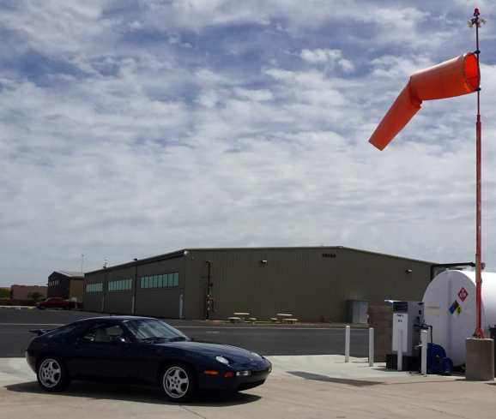
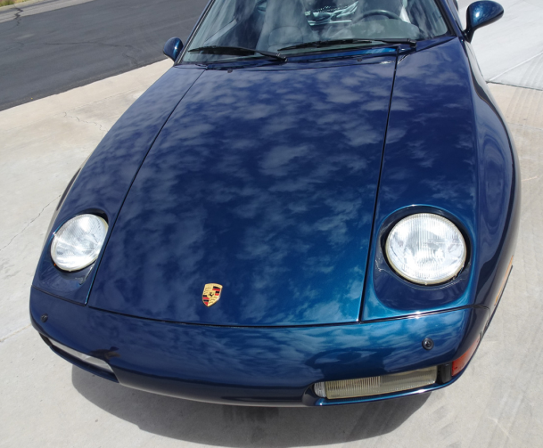
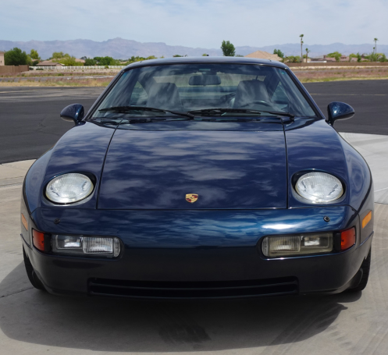
How Shiny is Shiny?
Start with Rich Andrade’s 1993 Amazon Green Porsche 928 GTS
Perform a spectacular multi-stage
cleaning/buffing with ceramic coating
Add a beautiful Arizona day with
some high fluffy clouds

Slide 2
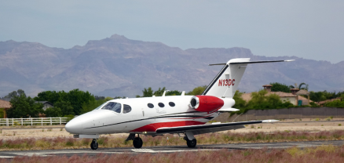
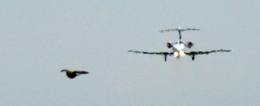
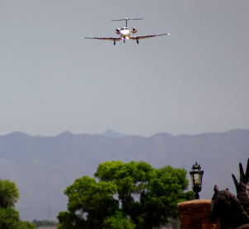
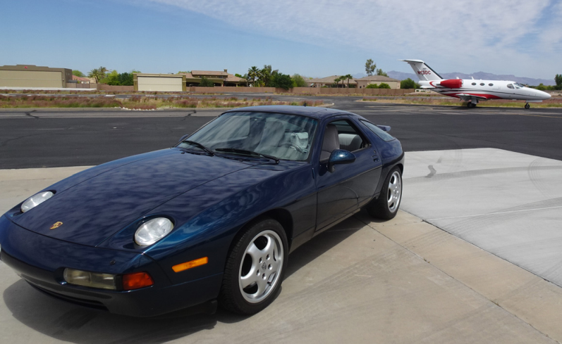
Do You Have Traffic In Sight?
This 2009 Cessna Citation Mustang 510 just
arrived from a 56 min flight from McClellan
-Palomar Airport near Carlsbad, California
During our photo shoot, a jet
is coming in to land. I hope
we aren’t in the way
There was taxi clearance

Slide 3
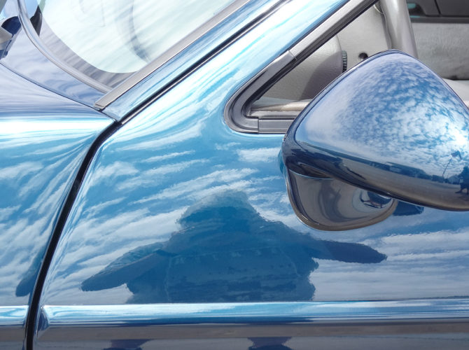
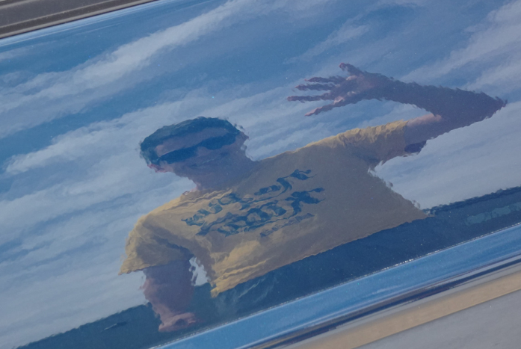
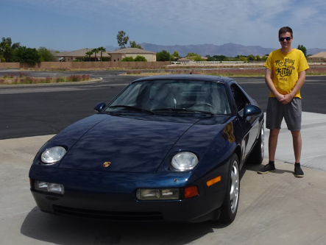
Traffic Was Not A Factor
Taking a closer look at the
shine
Who is the detail
Meister? He is
Mathias Baucum

Slide 4
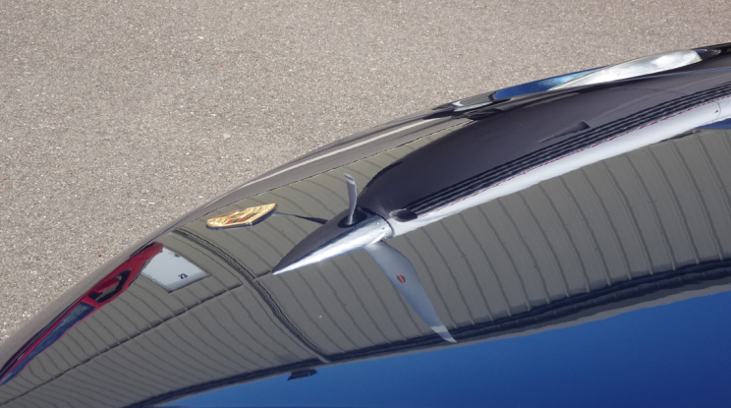
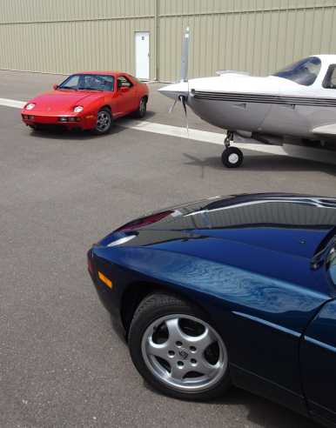
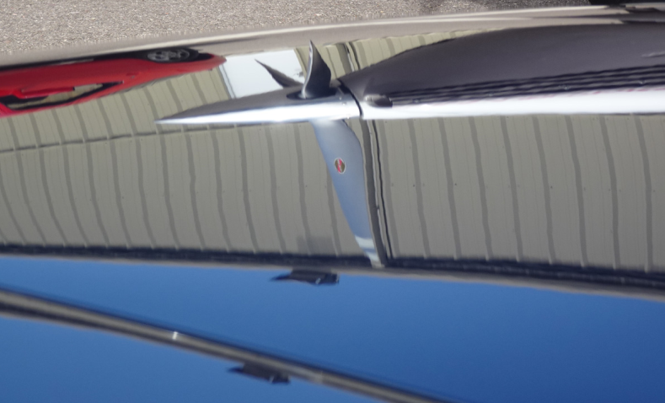
More Traffic
In Sight
The ceramic mirror coating keeps traffic in
sight from many angles
My Guards Red 1979 Porsche 928
is next in line for a ceramic coating
The Mooney M20R has already
had its ceramic coating applied
Wow what a shine!

Slide 5
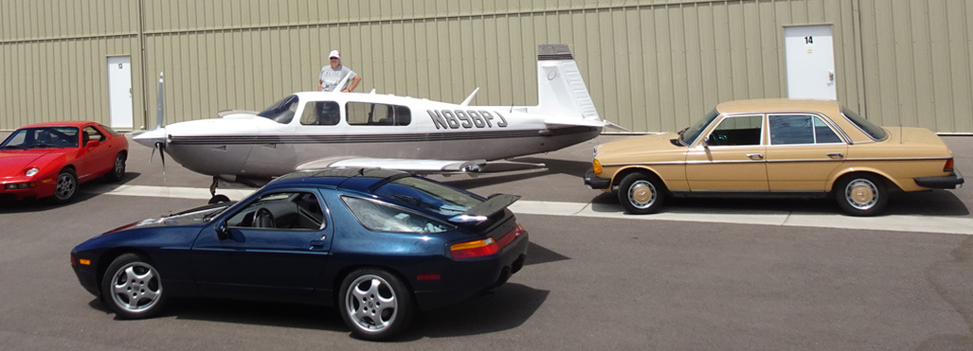
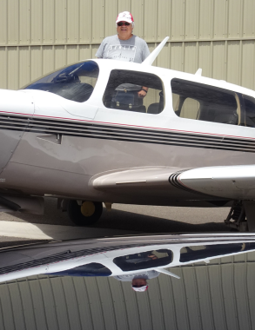
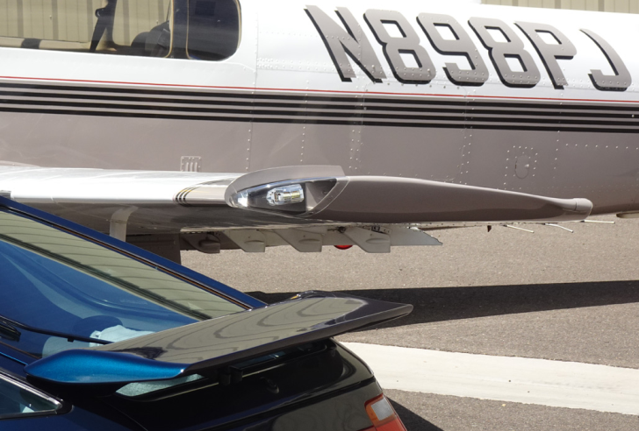
Even More Traffic In Sight
Mathias’ 1977
Mercedes 240D
was ceramic coated
over a year ago
Here I am in also in my
928 GTS roof shine
Ceramic coating helps all wings perform with
maximum efficiently

Slide 6
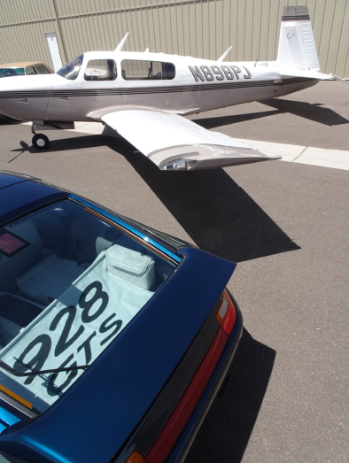
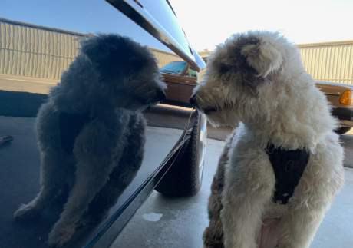
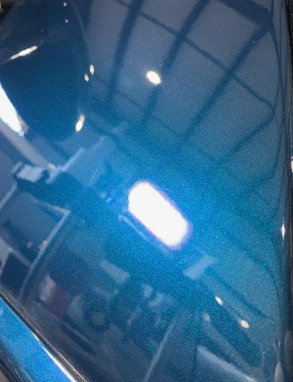
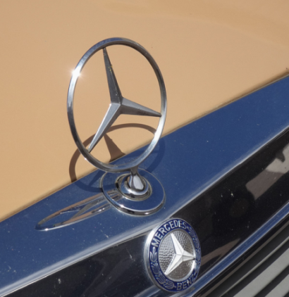

Slide 7
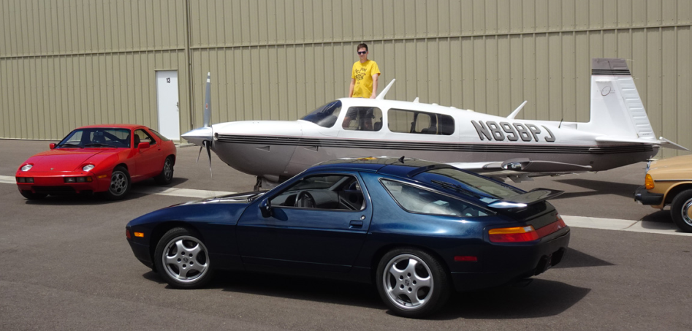
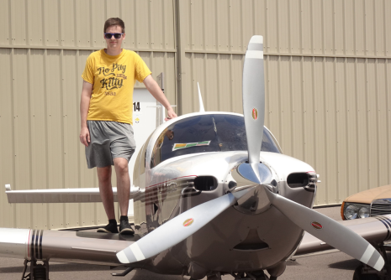
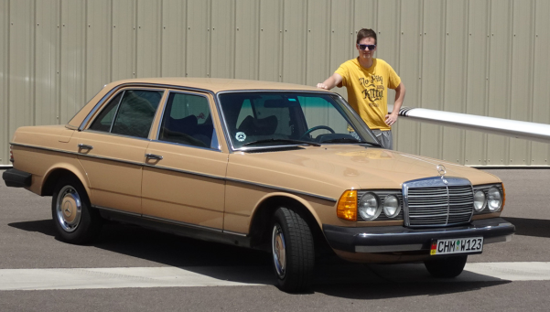
Mathias’ Handywork
Ceramic Coating from zero AGL to the Flight Levels
For more information,
contact:
mcbaucum@comcast.net

